Slide 1
SQL Insights (Preview)
Requirements
VM (Ubuntu 18.04) – we will start with recommended min spec Standard_B2s
Key Vault – for storing password for the SQL user
Data Collection Rule (monitoring profile) – Where the connection strings are stored
Next Steps
Is SQL Authentication enabled on all instances?
Port Configuration – Validate and document TCP port configuration
Monitoring of SQL instances both IaaS and MI
Enhancing our operational possibilities within the SQL space
Built upon Telegraf queries coming out of a Collector Agent (VM)

Slide 2
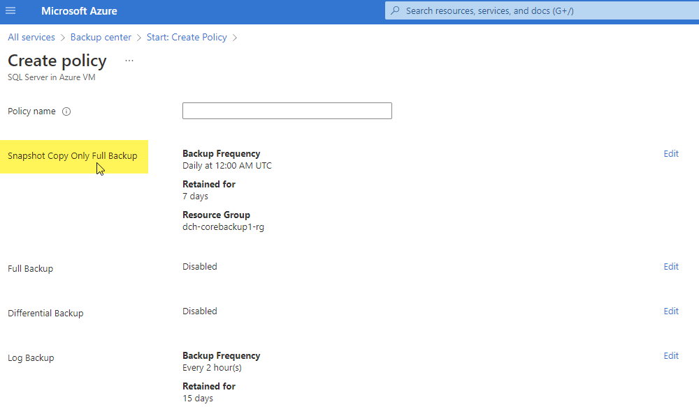
Snapshot-based SQL backup (Preview)
Requirements
Policy creation for this purpose – SAP Project has allowed for us to utilize YE1 SBX / YE6 as test cases
Next Steps
Enable Managed Identity on YE1 / YE6 VM
Assign permissions
Create New Policy – Only SAP-DEV is onboarded to Preview
Communicate status with SAP + Execute on backup
Link to Documents in Sharepoint
Snapshot based SQL backup to optimize performance on larger DBs (>6TB~)

